Slide 1

UNIT-I
LEXICAL ANALYSIS
SCS1303 Compiler Design
1

Slide 2
Outline
Role of Lexical Analyzer
  Lexical Analysis vs. Parsing
  Tokens, Patterns and Lexemes
  Attributes for tokens
  Lexical Errors
Input Buffering
SCS1303 Compiler Design

Slide 3
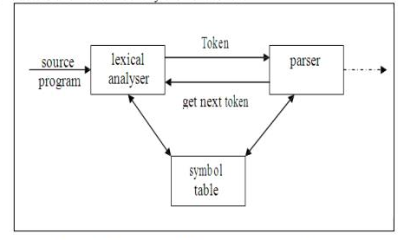
The Role of Lexical Analyzer
First phase of a compiler
Main Task:
Reads the input characters and produce as output a sequence of tokens that the parser uses for syntax analysis.
SCS1303 Compiler Design

Slide 4
The Role of Lexical Analyzer (Contd..)
Secondary tasks:
Eliminates the following from the source program:
  comments
  whitespaces
    tab
    newline characters
//global variables
printf( a);
a=a*2
printf(a)
SCS1303 Compiler Design

Slide 5
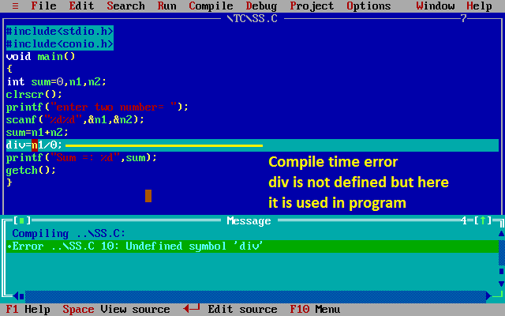
The Role of Lexical Analyzer (Contd..)
Correlating the error messages from the compiler with the source program.
  e.g. keeps track of the number of newline characters seen, so that a line number can be associated with an error message.
  Making a copy of source program with error marked( in some compilers).
SCS1303 Compiler Design

Slide 6
Lexical analysis vs. Parsing
Simplicity of design
  Separation of lexical from syntax phase -> simplify at least one of the tasks e.g. parser dealing with white spaces is complex job
  Unnecessary tokens can be eliminated by scanner
Improving compiler efficiency
  Liberty to apply specialized techniques that serves only lexical tasks not the whole parsing.
  Speedup reading input characters using specialized buffering techniques.
Enhancing compiler portability
  Input device peculiarities are restricted to the lexical analyzer, i.e. specialized symbols and characters (language and machine specific) are isolated during this phase.
SCS1303 Compiler Design

Slide 7
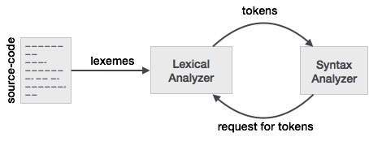
Tokens, Patterns and Lexemes
Tokens: Sequence of characters that have a collective meaning.
  Identifiers: names the programmer chooses.
  Keywords: names already in the programming language.
  Separators (also known as punctuators): punctuation characters and special symbols.
  Operators: symbols that operate on arguments .
  Literals: numeric, logical, textual, reference literals.
  A token is a pair a token name and an optional token value
SCS1303 Compiler Design

Slide 8
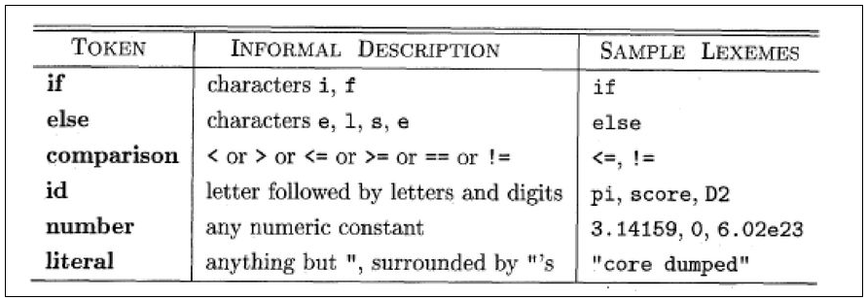
Tokens, Patterns and Lexemes(contd..)
Patterns: There is a set of strings in the input for which the same token is produced as output. This set of strings is described by a rule called a pattern associated with the token.
Lexeme: A sequence of characters in the source program that is matched by the pattern for a token.
Examples of tokens:
SCS1303 Compiler Design

Slide 9
Attributes for tokens
When more than one lexeme matches a pattern the lexical analyzer must provide additional information about that lexeme matched.
e.g. E = M * C ** 2;
Lexeme | <token, token attribute>
E | <id, pointer to symbol table entry for E>
= | <assign-op,>
M | <id, pointer to symbol table entry for M>
* | <mult-op,>
C | <id, pointer to symbol table entry for C>
** | <exp-op,>
2 | <number, integer value 2>
; | <separator, >
SCS1303 Compiler Design

Slide 10
Lexical errors
Some errors are out of power of lexical analyzer to recognize,
e.g. fi (a == f(x))
However it may be able to recognize errors like:
  e.g. d = 2r…..
such errors are recognized when no pattern for tokens matches a character sequence.
Panic mode Recovery:
Delete successive characters from the remaining input until the analyzer can find a well-formed token.(May confuse the parser-creating syntax error)
Other Error-recovery actions:
Delete an extraneous character
Inserting a missing character
Replacing an incorrect character by a correct character
Transposing two adjacent characters
SCS1303 Compiler Design

Slide 11
Input Buffering
Why we need input buffers?
Scanner performance is crucial:
  This is the only part of the compiler that examines the entire source code one character at a time.
  The scanner accounts for ~25-30% of total compile time.
  Lexical analyzer needs to lookahead some symbols to decide about the token to return.
Speedup the reading the source program.
We have two input buffer scheme that is useful when lookahead is necessary,
  Buffer pairs
  Sentinels
SCS1303 Compiler Design

Slide 12
Buffer Pairs
Buffer is divided into two N-characters halves.
N is number of characters e.g. 1024 or 4096
1st half
2nd half
N
N
SCS1303 Compiler Design

Slide 13
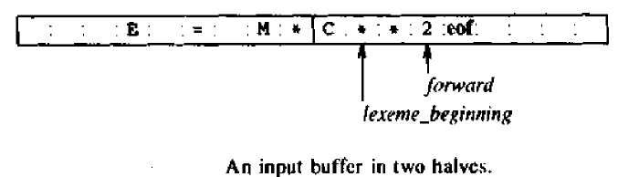
Buffer Pairs
Lexeme_beginning :marks the beginning of the current lexeme.
forward : scans ahead until a pattern match is found.
SCS1303 Compiler Design

Slide 14
Buffer Pairs (contd..)
Reads N input characters into each half of the buffer with system read command.
If fewer than N characters remain in the input ,then a special character eof is read into the buffer after the input characters.
The string of characters between the two pointers is the current lexeme.
Initially both pointer points to the first character of the next lexeme to be found.
With this scheme , comments and white spaces can be treated as pattern that yield no token.
SCS1303 Compiler Design

Slide 15
Buffer Pairs(contd..)
This buffering scheme works well most of the time, but the amount of lookahead is limited.
  Impossible to recognize token if the distance that the forward pointer must travel is more than the length of the buffer.
  e.g. DECLARE(ARG1,ARG2,ARG3…………..ARGn)
  unable to determine whether DECLARE is a keyword or an array name until the character that follows the right parenthesis is reached.
  In C language: we need to lookahead after,
  -, = or < to decide what token to return.
SCS1303 Compiler Design

Slide 16
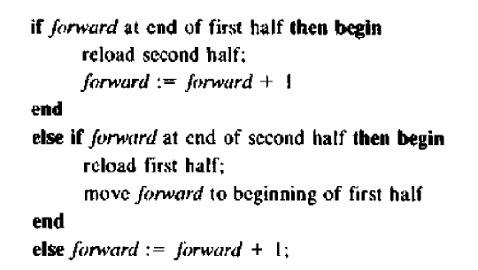
Code to advance forward pointer
SCS1303 Compiler Design

Slide 17
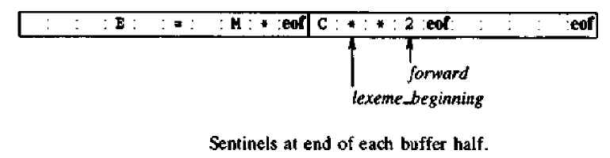
Sentinels
A special character at the buffer end.
SCS1303 Compiler Design

Slide 18
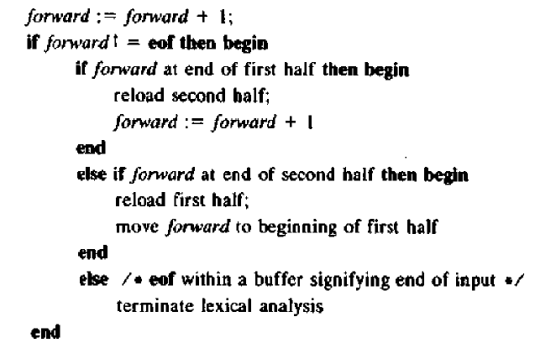
Lookahead code with sentinels
SCS1303 Compiler Design

Slide 19
THANK YOU
SCS1303 Compiler Design

